Slide 1
CSC2211 ALGORITHMS
INTRODUCTION
A. G. M. Zaman
Assistant Professor, Department of Computer Science, AIUB
agmzaman@aiub.edu

Slide 2
Vision & Mission of AIUB
VISION
AMERICAN INTERNATIONAL UNIVERSITY-BANGLADESH (AIUB) envisions promoting professionals and excellent leadership catering to the technological progress and development needs of the country.
MISSION
AMERICAN INTERNATIONAL UNIVERSITY-BANGLADESH (AIUB) is committed to provide quality and excellent computer-based academic programs responsive to the emerging challenges of the time. It is dedicated to nurture and produce competent world class professional imbued with strong sense of ethical values ready to face the competitive world of arts, business, science, social science and technology.

Slide 3
Goals of AIUB
Sustain development and progress of the university
Continue to upgrade educational services and facilities responsive of the demands for change and needs of the society
Inculcate professional culture among management, faculty and personnel in the attainment of the institution's vision, mission and goals
Enhance research consciousness in discovering new dimensions for curriculum development and enrichment
Implement meaningful and relevant community outreach programs reflective of the available resources and expertise of the university
Establish strong networking of programs, sharing of resources and expertise with local and international educational institutions and organizations
Accelerate the participation of alumni, students and professionals in the implementation of educational programs and development of projects designed to expand and improve global academic standards

Slide 4
Vision & Mission of Computer Science Department
VISION
Provides leadership in the pursuit of quality and excellent computer education and produce highly skilled and globally competitive IT professionals.
MISSION
Committed to educate students to think analytically and communicate effectively; train them to acquire technological, industry and research-oriented accepted skills; keep them abreast of the new trends and progress in the world of information communication technology; and inculcate in them the value of professional ethics.

Slide 5
Goals of Computer Science Department
Enrich the computer education curriculum to suit the needs of the industry- wide standards for both domestic and international markets
Equip the faculty and staff with professional, modern technological and research skills
Upgrade continuously computer hardware's, facilities and instructional materials to cope with the challenges of the information technology age
Initiate and conduct relevant research, software development and outreach services.
Establish linkage with industry and other IT-based organizations/institutions for sharing of resources and expertise, and better job opportunities for students

Slide 6
Course Objectives
The objective of this course is to teach how we can compare algorithms, the complexity analysis of time and space, effective data structure for solving difficult problems and implementation of different algorithms with the practical examples.
The purpose of the course is
  a) to raise your level of sophistication in thinking about the design and analysis of algorithms;
  b) learn some of the classic algorithms and recent improvements;
  c) exercise your creativity in designing algorithms.

Slide 7
Course Prerequisites
Programming
  Data types, operations
  Conditional statements
  Loops
  Procedures and functions
  C/ C++/ Java
Discrete Mathematics (proof theorems)
Data Structures (array, structure, pointer, file, etc...)
Computer lab (edit, compile, execute, debug)
If you lack of any of the above please refine yourselves.
Notes:
CSC2105
Sajib Hasan

Slide 8
Importance of the course
This course is a continuation of the courses Programming Language 1 & 2, and Data Structure.
Algorithm is required for all areas of computer science – especially for developing problem solving ability.
This course will give the basic for the understanding of the courses –Theory of Computation, Artificial Intelligence, etc.
This course will give the basic for the understanding of the concepts – Design and Analysis of Algorithm.

Slide 9
Course Contents
Introduction to Algorithms
Analysis of Algorithms
RAM model, Basic notation
Recurrences & Master Method
Dynamic Programming
Greedy strategy
Graphs Algorithms
Greedy Graph Algorithm
Shortest Path Algorithms
Basic idea of NP – Completeness
Basic idea of Elementary Geometric Methods & Review

Slide 10
Resources & References
Introduction to Algorithms, Third Edition, Thomas H. Cormen, Charle E. Leiserson, Ronald L. Rivest, Clifford Stein (CLRS).
Fundamental of Computer Algorithms, Ellis Horowitz, Sartaj Sahni, Sanguthevar Rajasekaran (HSR)
Helpful link for Problem Solving : http://acm.uva.es/problemset/
Lectures and Laboratory works will be provided online at the course website weekly.

Slide 11
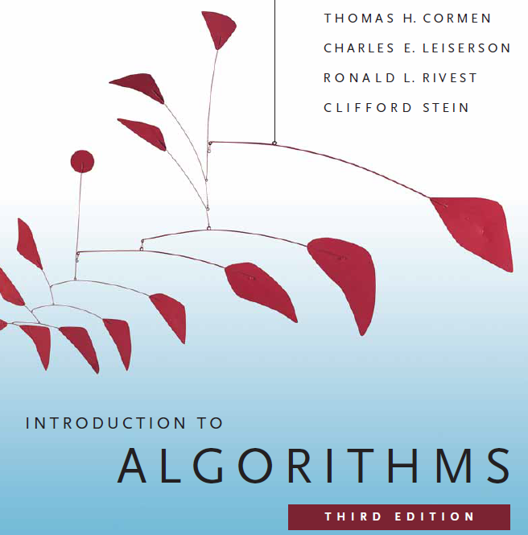

Slide 12
Course Evaluation
Midterm | Quiz (Best Two) | 20%
 | Laboratory Performance/Assignment/Exam | 20%
 | Class Attendance/Performance | 10%
 | Midterm Written Exam | 50%
 | Midterm Total | 100% | 40%
Final term | Quiz (Best Two) | 20%
 | Laboratory Performance/Assignment/Exam | 20%
 | Class Attendance/Performance | 10%
 | Final term Written Exam | 50%
 | Final Term Total | 100% | 60%
Grand Total | Grand Final of the Course |  | 100

Slide 13
Classroom Policies
Must be present inside the class in due time.
Class Break: I would prefer to start the class in due time and leave the class in 10/15 minutes early for theory/Laboratory class respectively, instead of giving a break.
Every class will start with a question-answer session about the last lecture. So students must be prepared with the contents and exercises from the last lecture.
Students are suggested to ask questions during or after the lecture.
Additional/bonus marks may be given to any good performances during the class/lab.
Late in Class:
  Student coming after 10 minutes of due time is considered late.
  3 late attendances are considered as one absent.
  Late during quiz/presentation are not given additional time.
  Students who are regularly late might have additional deduction of marks.
  A late student will be allowed to enter the class. Don’t ask permission to enter the class, just get in slowly and silently. Same policy implies if a student wants to go out of the class for emergency reasons.

Slide 14
Course Policies
Attendance
Laboratory Policies
Makeup Evaluation (quiz, assignment, etc.)
Grading Policies
Dropping a Course

Slide 15
Attendance
At least 75% presence is required by the student. Absent classes must be defended by the student through application and proper documentation to the course teacher.
Single absences or absences within 25% range will be judged by the course teacher.
Long absences/irregular presence/absences out of 25% range must go through application procedures via department Head (+ probation office, if student is in probation) to attend the following classes.
Acceptance of an application for absence only gives permission to attend the following classes. This might still result in deduction of marks (for attendance) which will be judged by the course teacher.

Slide 16
Laboratory Policies
  LABORATORY CLASSES:
    First 0.5 – 1 hour will be spent explaining the problems/task/experiment to be performed.
    Next 1 – 1.5 hour(s) will be spent by the students to complete the experiment.
    Next 0.5 – 1 hour will be spent in checking, marking, and discussing the solution.
    Students are allowed to discuss with each other (unless instructed not to) in solving problems.
    But the checking (executing/viva) & marking will be with individual students only.
  LABORATORY EXAM:
    Laboratory exam is scheduled in the week before the major exams, during normal laboratory hours.
    Generally students are given one/more problems to be solved of which at least one part is solved using computers.
    One hour is given to the students to solve the problem. And half hour to submit and viva. Generally 20 students in the first 1.5 hours and the other 20 students in the rest 1.5 hours.
    Students may be given choices to select the problem. At most 3 selection can be given to a student with 0, 2, and 4 marks deduction as a penalty for each selection respectively.
    Only in case of unavoidable circumstances, the laboratory exams may be taken in the off days or week after the major exams.

Slide 17
Makeup Evaluation
There will be no makeup quiz as long as a student have appeared in 2 quizzes.
Makeup for missing evaluations like quizzes/assignment submission date/presentation date/viva date/etc., must go through valid application procedure with supporting document within the deadline of the actual evaluation date.
Makeup for missing Midterm/Final term must go through Set B form along with the supporting document within the 1st working day after exam week. The set B exam is generally scheduled from the 2nd working day after the exam week. Must get signature and exam date from the course teacher and get it approved by the department Head (monetary penalty might be imposed).
Students unable to attend the set B exam may apply for set C exam within the same time limit as set B. Such applications must be supported by very strong reason and documentation, as they are generally rejected.
The course teacher will be the judge of accepting/rejecting the request for makeup.

Slide 18
Grading Policies
All the evaluation categories & marks will be uploaded to the VUES within one week of the evaluation process except the attendance & performance, which will be uploaded along with the major (mid/final term) written exam marks.
Letter grades ‘A+’ through ‘F’ is counted as grades. Other grades ‘I’ and ‘UW’ are considered as temporary grades which are counted/calculated as ‘F’ grade in the CGPA. These grades must/will be converted to the actual grades, i.e. ‘A+’ through ‘F’.
‘I: INCOMPLETE’ is given to students who have missed at most 30% of evaluation categories (quiz/assignment/etc.). Students must contact the course teacher for makeup, through valid application procedures immediately after grade release.
‘UW: UNOFFICIAL WITHDRAW’ is given when the missing evaluation categories are too high (more than 30%) to makeup. A student getting ‘UW’ has no option but to drop the course immediately after grade release

Slide 19
Grading Policies…
Once a student’s gets ‘I’ or ‘UW’ and unable to fulfill the requirements with the course teacher for makeup, must drop the course within officially mentioned time period from the registration department.
Students in probation or falls into the probation due to ‘I’/’UW’ grade are not allowed to drop the course.
Unable to do so will result in the automatic conversion of the grades ‘I’/’UW’ to ‘F’ grade after the 4th week of the following semester.
Any problem with the mark/grade must be consulted with the course teacher within one week of the release of grades.

Slide 20
Dropping a Course
Must fill up the drop form and get it signed by the course teacher, write an application to the vice chancellor and get it signed by the department Head, and finally submit the form & application to the registration department.
The course teacher must write down the grades (if any) obtained in midterm, final, and grand total on the drop form.
No drop is accepted during the following periods:
  One week before midterm exam – grade release date of midterm exam.
  One week before final term exam – grade release date of final grade.
Student with ‘F’ grades in midterm, final term, or grand total cannot drop.
Probation student are not allowed to drop any course.

Slide 21
Contacts
Contact information (email, office phone extension, office location, consulting hours, etc.) of the course teacher must be stored by the students.
It is mandatory to contact/notify (preferably consulting hour/email) the course teacher for/of any problems/difficulties at the earliest possible. Late notification might not be considered.
Update & correct your email address & phone number at VUES, as the teacher will contact/notify you of anything regarding the course through these information in VUES.

Slide 22
Finally
For any problems that could not be solved/understood during the lecture, students are advised to contact during the consultation hours and solve the problem.
For any missing evaluation (quiz, assignment, etc.), classes, deadlines, etc. must contact/inform/notify the teacher immediately after missing in the consulting hour, via email, or in unavoidable circumstances – through the guardian or friend.
Probation students must meet the course teacher once a week. So schedule your time with the teacher.
Any kind of dishonesty, plagiarism, misbehavior, misconduct, etc. will not be tolerated. Might result in deduction of marks, ‘F’ grade, or reported to the AIUB Disciplinary Committee for drastic punishment.
Always check/visit the AIUB home page for notices, rules & regulations of academic/university policies and important announcement for deadlines (Course drop, Exam permit, Exam Schedule, etc.).

Slide 23


Slide 24
??????
What will we do/learn in this course?

Slide 25
The Goals of this Course
To think algorithmically
To understand and learn the idea behind algorithm design techniques
To get to know a toolbox of classical algorithms.
To reason (in a precise and formal way) about the efficiency and the correctness of algorithms.
Notes:
CSC2105
Sajib Hasan

Slide 26
I would request all of you to...
Be simple and precise in understanding the problem
Solve the problem first on the paper and then keyed in on the computer.
During lectures:
  Interaction is welcome; ask questions.
  Additional explanations and examples if desired.
  Speed up/slow down the progress.
Notes:
CSC2105
Sajib Hasan

Slide 27
??????
What is an Algorithm?
A set of steps to accomplish a task.

Slide 28
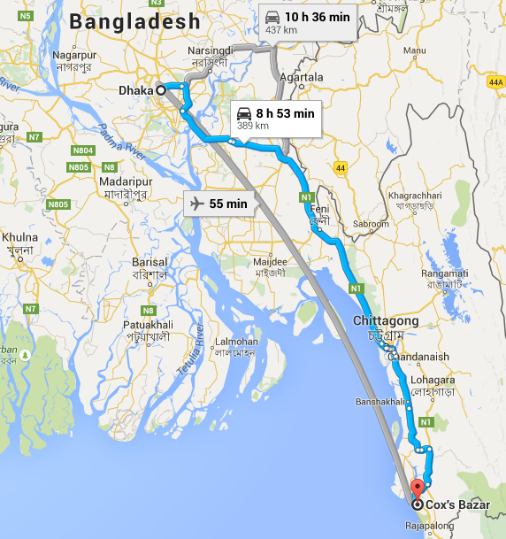
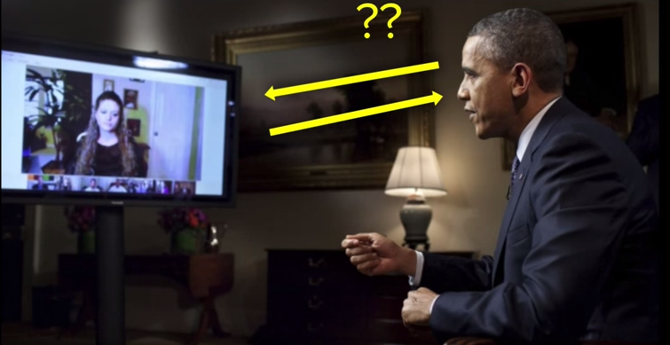
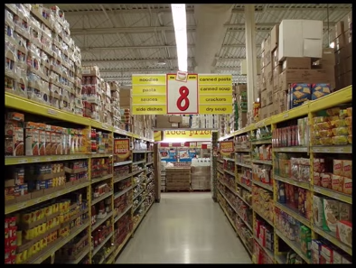
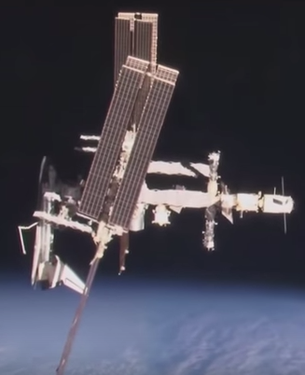

Slide 29
Informally
takes some value or set of values as input
produces some value or set of values, as output
Algorithm: any well-defined computational procedure
An algorithm is thus a sequence of computational steps that transform the input into the output.
Solving a given problem:
  Data structure: Organization of data to solve the problem at hand.
  Algorithm: Outline, the essence of a computational procedure, step-by-step instructions.
  Program: Implementation of an algorithm in some programming language.

Slide 30
Kinds of Problem to be solved
Sorting and Searching are the basic and most common computational problem.
Clever algorithms are employed for the Internet
  to manage large volume of data transfer.
  Finding good routes on which the data will travel.
  Search engine to quickly find requested pages.
  Etc…
Numerical algorithms and number theory are employed in electronic commerce to keep and secure information such as credit card numbers, passwords, and bank statements.

Slide 31
Kinds of Problem to be solved
Allocating scarce resources in the most beneficial way.
  An oil company may wish to know where to place its wells in order to maximize its expected profit.
  A candidate may want to determine where to spend money buying campaign advertising in order to maximize the chances of winning at election.
  An airline may wish to assign crews to flight in the least expensive way possible, making sure that each flight is covered and that government policy regarding crew policies are met.
  Etc…

Slide 32
Algorithmic problem
Specification of output as a function of input
Specification of input
Algorithm
Finite number of input instances satisfying the specification.
For example:
  A sorted, non-decreasing sequence of natural numbers. The sequence is of non-zero, finite length:
    1, 20, 908, 909, 100000, 1000000000.
    3.
Notes:
CSC2105
Sajib Hasan

Slide 33
Algorithmic Solution
Input instance, adhering to the specification
Output related to the input as required
Algorithm
Algorithm describes actions on the input instance.
There may be many correct algorithms for the same algorithmic problem.

Slide 34
Definition of an Algorithm
An algorithm is a sequence of unambiguous instructions for solving a problem, i.e., for obtaining a required output for any legitimate input in a finite amount of time.
Properties:
  Generality - the algorithm should be applicable to all problems of a similar form
  Correctness - should produce the correct output
  Effectiveness - each step must be able to be performed in a finite amount of time
  Definiteness: the steps are defined precisely
  Finiteness - the steps required should be finite
  Efficiency
Notes:
CSC2105
Sajib Hasan

Slide 35





Overall Picture
Using a computer to help solve
problems.
Precisely specify the problem.
Designing programs
  Architecture → data structure
  Technique → algorithms
Writing programs
Verifying (testing) programs
Data Structure and Algorithm Design Goals
Correctness
Efficiency
Implementation Goals
Adaptability
Reusability
Robustness
Notes:
CSC2105
Sajib Hasan

Slide 36
How to Develop an Algorithm?
Precisely define the problem.
  Precisely specify the input and output.
  Consider all cases.
Come up with a simple plan to solve the problem at hand.
  The plan is language independent.
  The precise problem specification influences the plan.
Turn the plan into an implementation
  The problem representation (data structure) influences the implementation.
Notes:
CSC2105
Sajib Hasan

Slide 37
??????
Suppose computers were infinitely fast and computer memory was free. Would you have any reason to study algorithms?

Slide 38
Algorithm Analysis

Slide 39
Analysis of Algorithms
Efficiency:
  Running time
  Space used
Efficiency as a function of the input size:
  Number of data elements (numbers, points).
  The number of bits of an input number .

Slide 40
The RAM model
Machine-independent algorithm design depends upon a hypothetical computer called the Random Access Machine or RAM.
In computer science, random-access machine (RAM) is an abstract machine
The RAM model:
  Each “simple” operation (+, *, -, =, if, call) takes exactly 1 time step
  Loops and subroutines are not considered simple operations. Instead, they are the composition of many single-step operations. It makes no sense for “sort” to be a single-step operation, since sorting 1,000,000 items will take much longer than sorting 10 items. The time it takes to run through a loop or execute a subprogram depends upon the number of loop iterations or the specific nature of the subprogram.
  Each memory access takes exactly one time step, and we have as much memory as we need. The RAM model takes no notice of whether an item is in cache or on the disk, which simplifies the analysis.

Slide 41
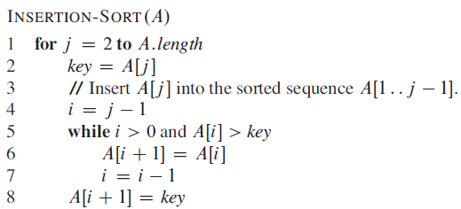
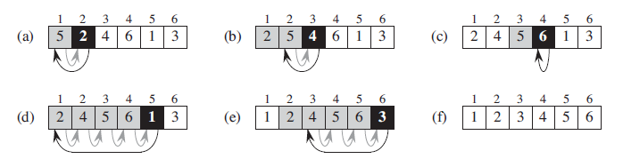
Insertion Sort

Slide 42
Loop invariants and the correctness of insertion sort
Initialization: It is true prior to the first iteration of the loop.
Maintenance: If it is true before an iteration of the loop, it remains true before the next iteration.
Termination: When the loop terminates, the invariant gives us a useful property that helps show that the algorithm is correct.

Slide 43
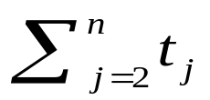
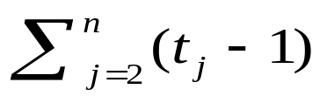
Analysis of Insertion Sort
Time to compute the running time as a function of the input size (exact analysis).
for j := 2 to n do
key := A[j]
// Insert A[j] into A[1..j-1]
i := j-1
while i>0 and A[i]>key do
A[i+1]:=A[i]
i--
A[i+1]:=key
cost
c₁
c₂
0
c₃
c₄
c₅
c₆
c₇
times
n
n-1
n-1
n-1
n-1

Slide 44
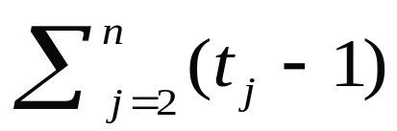
…Analysis of Insertion Sort
The running time of an algorithm is the sum of the running times of each statement.
A statement with cost c that is executed n times contributes c*n to the running time.
The total running time T(n) of insertion sort is
  T(n)= c₁*n + c₂(n-1) + c₃(n-1) + c₄ + c₅ + c₆
  + c₇ (n-1)

Slide 45
…Analysis of Insertion Sort
Often the performance depends on the details of the input (not only the length n).
This is modeled by t_{j.}
In the case of insertion sort the time t_{j} depends on the original sorting of the input array.

Slide 46
Performance Analysis
Performance often draws the line between what is feasible and what is impossible.
Often it is sufficient to count the number of iterations of the core (innermost) part.
  No distinction between comparisons, assignments, etc (that means roughly the same cost for all of them).
  Gives precise enough results.
In some cases the cost of selected operations dominates all other costs.
  Disk I/O versus RAM operations.
  Database systems.

Slide 47
Best/ Worst/ Average Case
Best case: works fast on some input.
Worst case: (usually) maximum time of algorithm on any input of size.
Average case: (sometimes) expected time of algorithm over all inputs of size. Need assumption of statistical distribution of inputs.
Analyzing insertion sort’s
  Best case: elements already sorted, t_{j}=1, running time ≈ (n-1), i.e., linear time.
  Worst case: elements are sorted in inverse order, t_{j} = j-1, running time ≈ (n²-n)/2 , i.e., quadratic time.
  Average case: t_{j} = j / 2, running time ≈ (n²+n-2)/4 , i.e., quadratic time.

Slide 48
…Best/ Worst/ Average Case
  For inputs of all sizes:
worst-case
6n
average-case
5n
best-case
Running time
4n
3n
2n
1n
1 2 3 4 5 6 7 8 9 10 11 12 …..
Input instance size

Slide 49
…Best/ Worst/ Average Case
Worst case is usually used:
  It is an upper-bound.
  In certain application domains (e.g., air traffic control, surgery) knowing the worst-case time complexity is of crucial importance.
  For some algorithms worst case occurs fairly often
  The average case is often as bad as the worst case.
  Finding the average case can be very difficult.

Slide 50



Asymptotic Notation
The “big-Oh” O-Notation
  asymptotic upper bound
  f(n) = O(g(n)), if there exists constants c>0 and n₀>0, s.t. f(n) ≤ c g(n) for n ≥ n₀
  f(n) and g(n) are functions
  over non- negative integers
Used for worst-case analysis
f(n) = 3n + 2, find value c and n0.
C = 4, and n0>=2
Running Time
Input Size

Slide 51

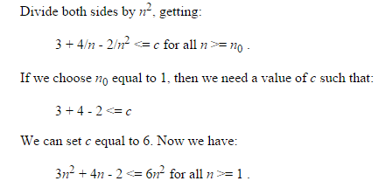
Asymptotic Notation

Slide 52


...Asymptotic Notation
The “big-Omega” Ω−Notation
  asymptotic lower bound
  f(n) = Ω(g(n)) if there exists constants c>0 and n₀>0, s.t. c g(n) ≤ f(n) for n ≥ n₀
Used to describe best-case running times or lower bounds of algorithmic problems.
E.g., lower-bound of searching in an unsorted array is Ω(n).
f(n) = 3n + 2, find value c and n0.
C = 1, and n0>=1
Running Time
Input Size

Slide 53


...Asymptotic Notation
The “big-Theta” Θ−Notation
  asymptoticly tight bound
  f(n) = Θ(g(n)) if there exists constants c₁>0, c₂>0, and n₀>0, s.t. for n ≥ n₀ c₁ g(n) ≤ f(n) ≤ c₂ g(n)
f(n) = Θ(g(n)) if and only if f(n) = Ο(g(n)), f(n) = Ω(g(n))
O(f(n)) is often abused instead of Θ(f(n))
Running Time
Input Size

Slide 54
Asymptotic Analysis
Goal: to simplify the analysis of the running time by getting rid of details, which are affected by specific implementation and hardware
  rounding of numbers: 1,000,001 ≈ 1,000,000
  rounding of functions: 3n² ≈ n²
Capturing the essence: how the running time of an algorithm increases with the size of the input in the limit.
  Asymptotically more efficient algorithms are best for all but small inputs

Slide 55
...Asymptotic Analysis
Simple Rule: Drop lower order terms and constant factors.
  50 n log n is O(n log n)
  7n - 3 is O(n)
  8n² log n + 5n² + n is O(n² log n)
Note: Although (50 n log n) is O(n⁵), it is expected that an approximation is of the smallest possible order.

Slide 56
Correctness of Algorithms
An algorithm is correct if for any legal input it terminates and produces the desired output.
Automatic proof of correctness is not possible (so far).
There are practical techniques and rigorous formalisms that help to reason about the correctness of (parts of) algorithms.

Slide 57
Partial and Total Correctness
  Partial correctness
IF this point is reached,
THEN this is the desired output
Any legal input
Algorithm
Output
  Total correctness
INDEED this point is reached,
AND this is the desired output
Any legal input
Algorithm
Output

Slide 58
Assertions
To prove partial correctness we associate a number of assertions (statements about the state of the execution) with specific checkpoints in the algorithm.
  E.g., A[1], …, A[ j ] form an increasing sequence
Preconditions – assertions that must be valid before the execution of an algorithm or a subroutine (INPUT).
Postconditions – assertions that must be valid after the execution of an algorithm or a subroutine (OUTPUT).

Slide 59
Pre/post-conditions
Example:
  Write a pseudocode algorithm to find the two smallest numbers in a sequence of numbers (given as an array).
INPUT: an array of integers A[1..n], n > 0
OUTPUT: (m1, m2) such that
  m1<m2 and for each i∈[1..n]: m1 ≤ A[i] and, if A[i] ≠ m1, then m2 ≤ A[i].
  m2 = m1 = A[1] if ∀j,i∈[1..n]: A[i]=A[j]

Slide 60
Loop Invariants
Invariants: assertions that are valid any time they are reached (many times during the execution of an algorithm, e.g., in loops)
We must show three things about loop invariants:
  Initialization: it is true prior to the first iteration.
  Maintenance: if it is true before an iteration, then it is true after the iteration.
  Termination: when a loop terminates the invariant gives a useful property to show the correctness of the algorithm

Slide 61
Example: Binary Search
l := 1
r := n
do
m := ⎣(l+r)/2⎦
if A[m] = q then return m
else if A[m] > q then r := m-1
else l := m+1
while l <= r
return NIL
We want to show that q is not in A if NIL is returned.
Invariant:
∀i∈[1..l-1]: A[i]<q  (Ia)
∀i∈[r+1..n]: A[i]>q (Ib)
Initialization: l = 1, r = n the invariant holds because there are no elements to the left of l or to the right of r.
l=1 yields ∀j,i ∈[1..0]: A[i]<q
this holds because [1..0] is empty
r=n yields ∀j,i ∈[n+1..n]: A[i]>q
this holds because [n+1..n] is empty

Slide 62
…Example: Binary Search
l := 1
r := n
do
m := ⎣(l+r)/2⎦
if A[m] = q then return m
else if A[m] > q then r := m-1
else l := m+1
while l <= r
return NIL
Invariant:
∀i∈[1..l-1]: A[i]<q (Ia) ∀i∈[r+1..n]: A[i]>q (Ib)
Maintenance: l, r, m = ⎣(l+r)/2⎦
A[m]!=q & A[m]>q, r=m-1, A sorted implies
∀k∈[r+1..n]: A[k]>q (Ib)
A[m]!=q & A[m]<q, l=m+1, A sorted implies
∀k∈[1..l-1]: A[k]<q (Ia)

Slide 63
…Example: Binary Search
Invariant:
∀i∈[1..l-1]: A[i]<q (Ia) ∀i∈[r+1..n]: A[i]>q (Ib)
l := 1
r := n
do
m := ⎣(l+r)/2⎦
if A[m] = q then return m
else if A[m] > q then r := m-1
else l := m+1
while l <= r
return NIL
Termination: l, r, l<=r
Two cases:
  l:=m+1 we get ⎣(l+r)/2⎦ +1 > l
  r:=m-1 we get ⎣(l+r)/2⎦ -1 < r
The range gets smaller during each iteration and the loop will terminate when l<=r no longer holds.

Slide 64
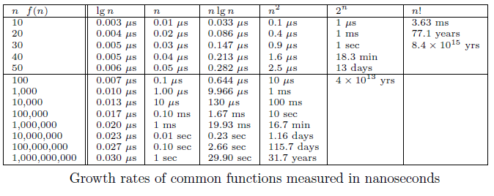
Growth Rates and Dominance Relations

Slide 65
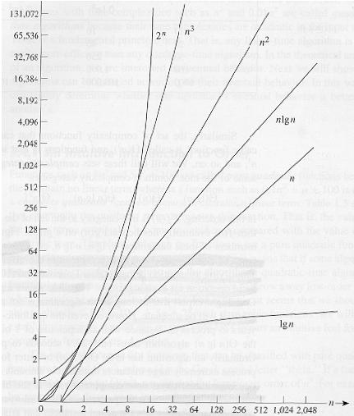

Slide 66
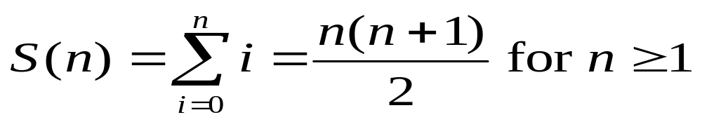
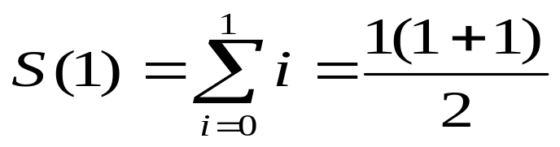
Proof by Induction
We want to show that property P is true for all integers n ≥ n₀.
Basis: prove that P is true for n₀.
Inductive step: prove that if P is true for all k such that n₀ ≤ k ≤ n – 1 then P is also true for n.
Example
Basis

Slide 67
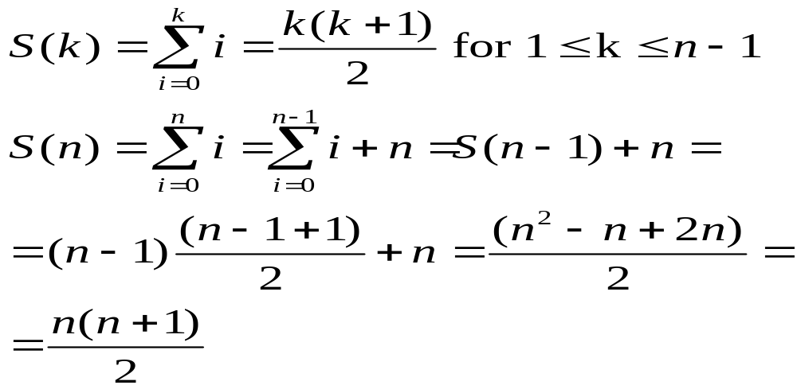
...Proof by Induction
Inductive Step

Slide 68
Example: Proof by induction
1*2 + 2*3 + 3*4 + . . . n*(n+1) = n*(n+1)(n+2)/3 n>=1
2 + 2^2 +2^3 + 2^4 + … +2^n = 2^(n+1) -2 n>=1

Slide 69
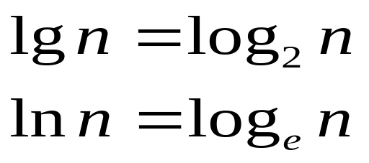
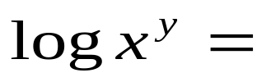



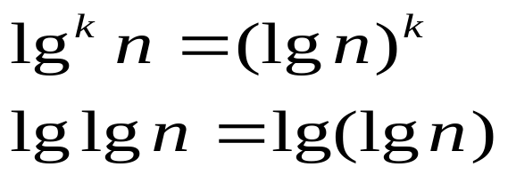
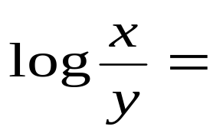




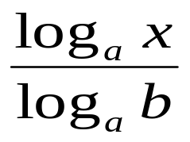
Logarithms and properties
In algorithm analysis we often use the notation “log n” without specifying the base
Binary logarithm
Natural logarithm

Slide 70
More Examples
For each of the following pairs of functions, either f(n) is O(g(n)), f(n) is Ω(g(n)), or f(n) = Θ(g(n)). Determine which relationship is correct.
  f(n) = log n²; g(n) = log n + 5
  f(n) = n; g(n) = log n²
  f(n) = log log n; g(n) = log n
  f(n) = n; g(n) = log² n
  f(n) = n log n + n; g(n) = log n
  f(n) = 10; g(n) = log 10
  f(n) = 2^{n}; g(n) = 10n²
  f(n) = 2^{n}; g(n) = 3^{n}
f(n) = Θ (g(n))
f(n) = Ω(g(n))
f(n) = O(g(n))
f(n) = Ω(g(n))
f(n) = Ω(g(n))
f(n) = Θ(g(n))
f(n) = Ω(g(n))
f(n) = O(g(n))

Slide 71
Properties
Theorem:
f(n) = Θ(g(n)) ⇔ f = O(g(n)) and f = Ω(g(n))
Transitivity:
  f(n) = Θ(g(n)) and g(n) = Θ(h(n)) ⇒ f(n) = Θ(h(n))
  Same for O and Ω
Reflexivity:
  f(n) = Θ(f(n))
  Same for O and Ω
Symmetry:
  f(n) = Θ(g(n)) if and only if g(n) = Θ(f(n))
Transpose symmetry:
  f(n) = O(g(n)) if and only if g(n) = Ω(f(n))

Slide 72
Asymptotic Notations in Equations
On the right-hand side
  Θ(n²) stands for some anonymous function in Θ(n²)
  2n² + 3n + 1 = 2n² + Θ(n) means:
  There exists a function f(n) ∈ Θ(n) such that
  2n² + 3n + 1 = 2n² + f(n)
On the left-hand side
  2n² + Θ(n) = Θ(n²)
  No matter how the anonymous function is chosen on the left-hand side, there is a way to choose the anonymous function on the right-hand side to make the equation valid.

Slide 73
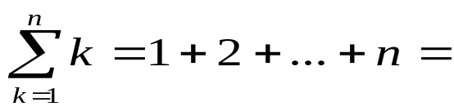
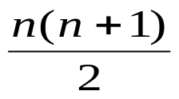
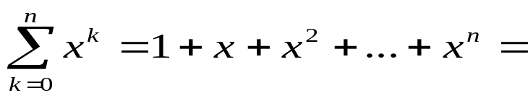
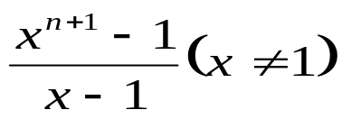
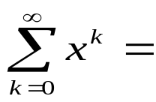
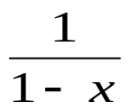
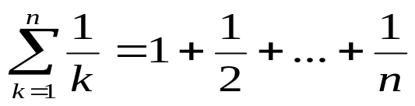

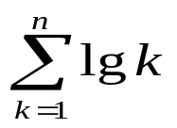

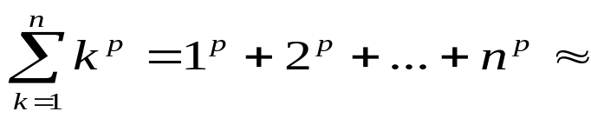
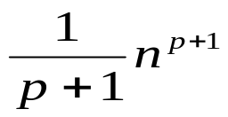
Common Summations
Arithmetic series:
Geometric series:
  Special case: |x| < 1:
Harmonic series:
Other important formulas:

Slide 74
Example
Prove that: 2n + 1 ≤ 2^{n} for all n ≥ 3
Basis step:
  n = 3: 2 ∗ 3 + 1 ≤ 2³ ⇔ 7 ≤ 8 TRUE
Inductive step:
  Assume inequality is true for n, and prove it for (n+1):
  2n + 1 ≤ 2^{n} must prove: 2(n + 1) + 1 ≤ 2^{n+1}
  2(n + 1) + 1 = (2n + 1 ) + 2 ≤ 2^{n} + 2 ≤
  ≤ 2^{n} + 2^{n} = 2^{n+1}, since 2 ≤ 2^{n} for n ≥ 1

Slide 75
Sorting
Simple sorting methods use roughly n * n comparisons
  Insertion sort
  Selection sort
  Bubble sort
Fast sorting methods use roughly n * log n comparisons.
  Merge sort
  Heap sort
  Quicksort
Notes:
CSC2105
Sajib Hasan

Slide 76
References & Readings
CLRS
  Chapters: 1, 2 (2.1, 2.2), 3
  Exercises: 1.2-2, 1.2-3, 2.1-3, 2.1-4, 2.2-1, 2.2-3, 3.1-1, 3.1-4, 3.1-6, 3.1
  Problems: 1-1, 3-3
HSR
  Chapters: 1 (1.1-1.3)
  Examples: 1.4-1.6, 1.11-1.13, 1.17-1.18
  Exercises: 1.3 (1-4, 8, 9)
Review for laboratory
  HSR
    Chapters: 2, 3.2 - 3.5
  CLRS
    Chapters: 6, 7, 10, 12

